Slide 1

Code Implementation For Category Part | By Robera Worku and Belayneh Mathewos

Slide 2
Description
Coding part
Item Post
Creat a form for a user to upload his items
Submit the items detail info into database
Item Display
retrieve detail infos of items from database
display detail infos of items

Slide 3
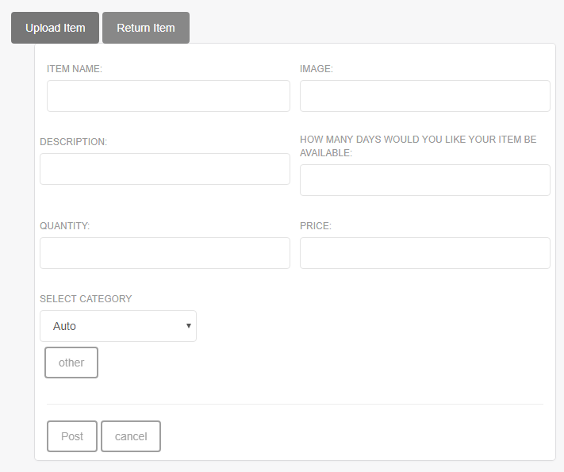
Cont. Item Post

Slide 4
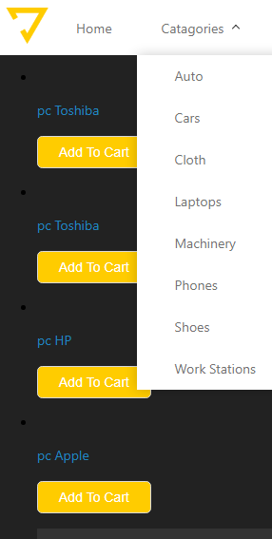
Cont. Item Display

Slide 5
How it works
Item Display
When a user wants to see an items details and he selects items category, it displays items if there are in database. Otherwise an empty .
Item Post
From item post form page
Take an item details
If post button is clicked, the details goes to database

